Slide 1
Superstore Sales Analysis-
Advanced Excel Project
Rohinth Shanmugasundaram
DADS
August 2025 batch
11/11/2025

Slide 2
Project Overview
The Data set provided with is Superstore dataset.
Here we analyze retail sales data.
The main objective is to give insights on how to increase the sales by supporting relevant metrics like discount, quantity etc.,
We can also suggest the retail store to how and where to focus their attention like specific product category or specific shipping channels.
So, this project will help the client to understand their performance and they will have their way to enhance it further.

Slide 3
Data Description and Preparation
Number of rows = 9994 rows of distinct values
There are no duplicate value
There are nearly 30 columns including the columns aggregated after analysis.
Important relevant columns are sales, discount, ship mode, category, segment, order date.

Slide 4
Data Description and Preparation
Data Cleaning:
With the help of spread ness of the data identified lower bound and upper bound values for both sales and discount, but as in this project there is no client interaction and proper insights on outlier they were not removed.
The Values are formatted to tables.
Data Validation Techniques are placed to intimidate the user on any negative values inputted on future.

Slide 5
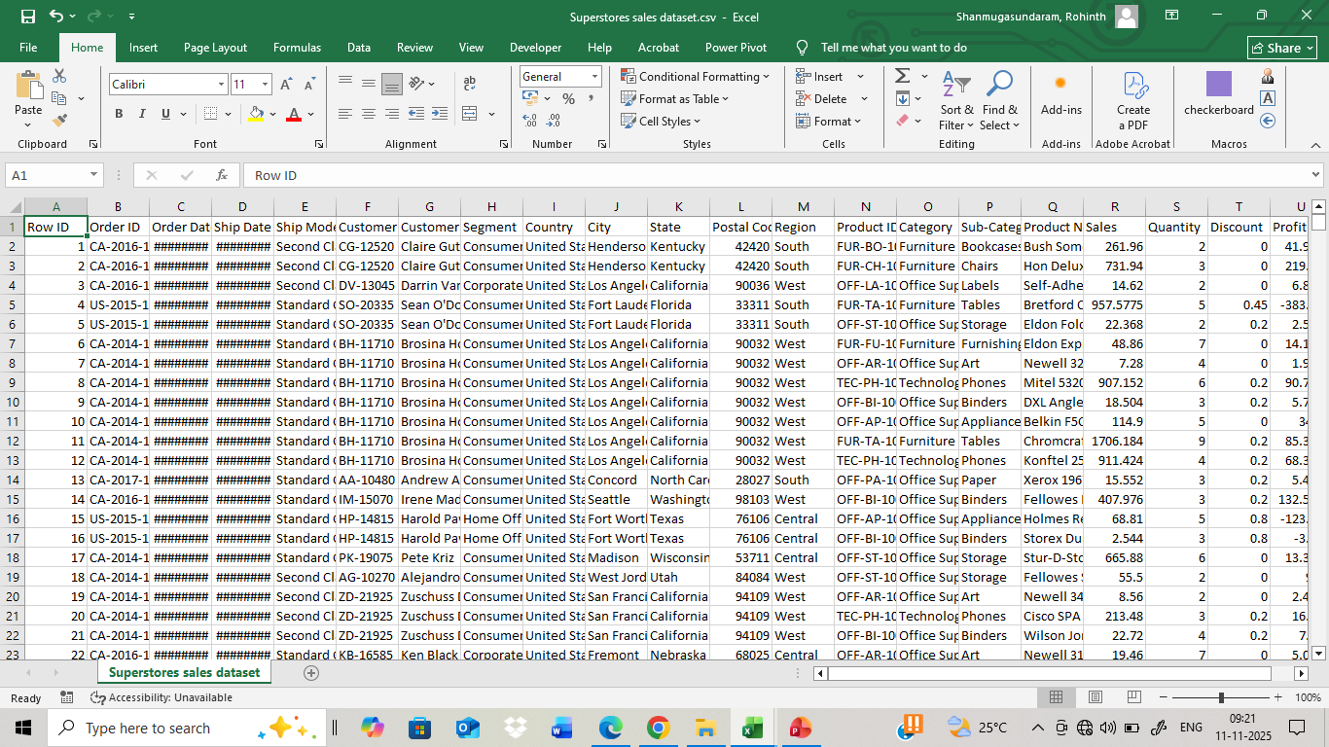
Data Before Cleaning

Slide 6
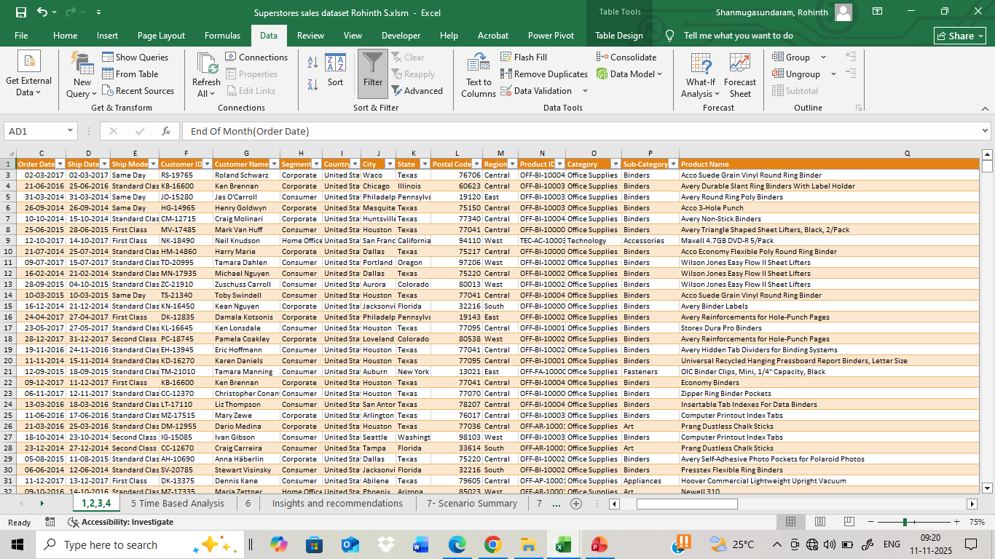
Data After Cleaning

Slide 7

Key Metrics and Data Analysis

Slide 8
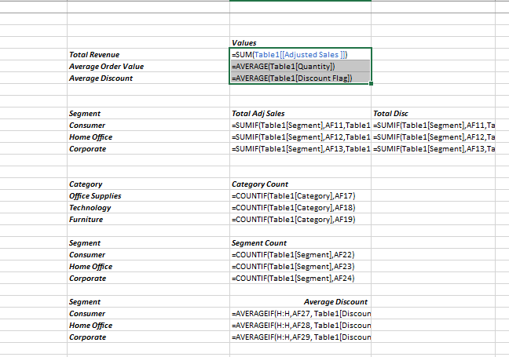

Slide 9
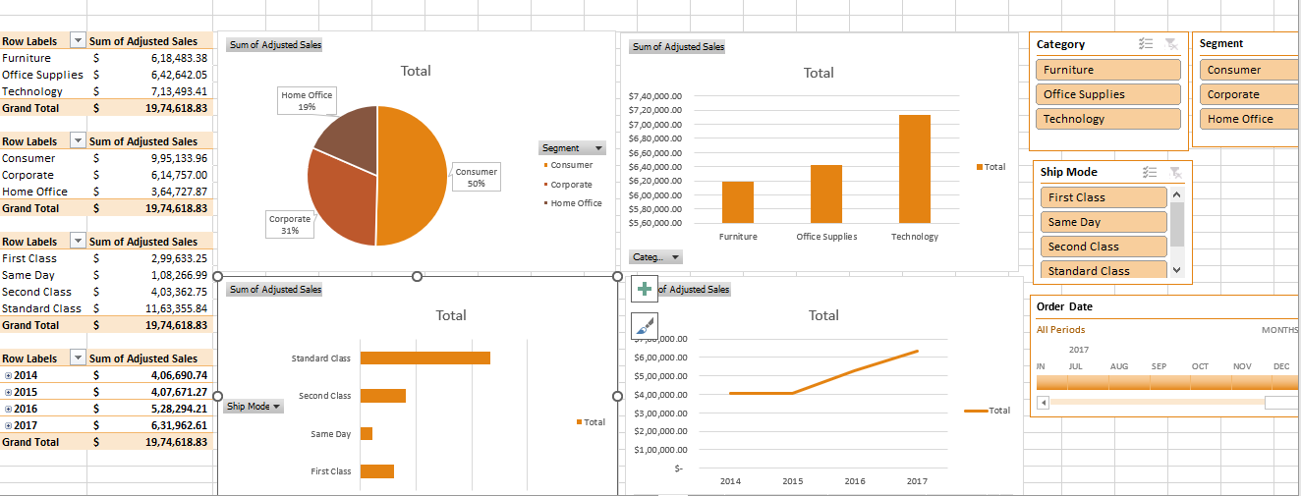
Pivot tables and Pivot Charts

Slide 10
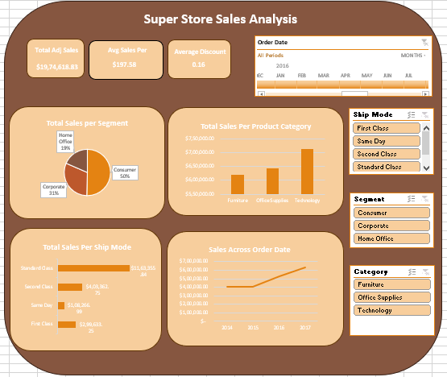
Dashboard

Slide 11
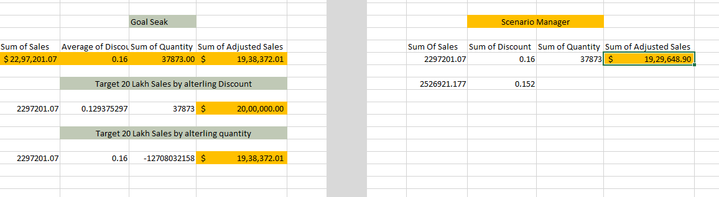
Goal Seak and Scenario Manager

Slide 12
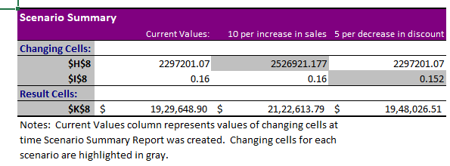

Slide 13
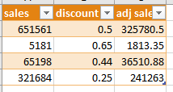
Marcos
Here I have recorded macros on – creating tables from a range of cells and then using formulas to create a new columns, I have found adj sales from sales and discount.
And used the recorded macros to reformulate a list of cells.

Slide 14
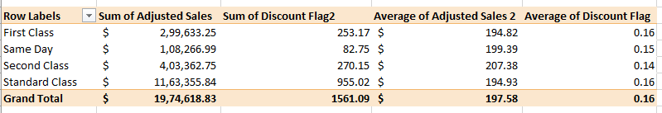
Insights and Recommendations – Ship Mode
Here in Ship Mode Standard class has Highest total sales but its average is lower, this implies that standard sales value per order of standard class is lesser.
This may imply 2 things the people who are ordering through standard class generally orders less value orders or the discount for standard class is very higher, but by checking the average discount it is optimal, so it may suggest the first thing.

Slide 15
Insights and Recommendations – Ship Mode
Here we can see the average of Second class is highest in the group, this may be because, the average discount is lower for second class.
So to increase the average sales through each of these channels, customizing discounts and decreasing discounts are the proven ways.

Slide 16
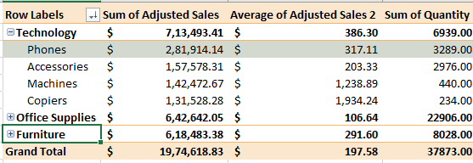
Insights and Recommendations – Product Category
we can see in product category The highest performing category is technology with 7 lakh dollars in sales with phones performing the highest even among every products with the sales of 2.8 lakh dollars.
But we can see that others are not performing badly as well they are neck to neck in sales.

Slide 17
Insights and Recommendations – Product Category
For future concentrations - focusing on most reliable products and products with the room of growth, phone can be one of such product with highest sales and we can see that machines and copiers have highest average sales as their sales is higher and the quantity sold is lesser.
so machines copiers and phones because of these reasons can be best for making it star products - altogether superstore can make technology as their star category.
.

Slide 18
Insights and Recommendations – Effect of Discount
Discount have a significant impact on the net sales, as due to large portions of the discount as you could the sales value have significantly resulting in reduced profit.
This might be due to unplanned excessive discount strategies or outliers
As one of max discount is accounted for 80 percent and as well the discount data skew is 1.6 directing towards outliers in data.

Slide 19

Conclusion

Slide 20
Conclusion

Slide 21
Conclusion
One of such strategies is to decrease average discount from 14 to 12.9 percentage. So that net profit can be up to 20 lakhs
And also to remove the outliers to get effective results with scenario manager, we can see that profit by 5 percent gives higher net overall profit, but the more
effective way is to increase sales by 10 percent, for which we should encourage promotions during seasons functions, festivals and holidays.

